Slide 1



















Slide 2

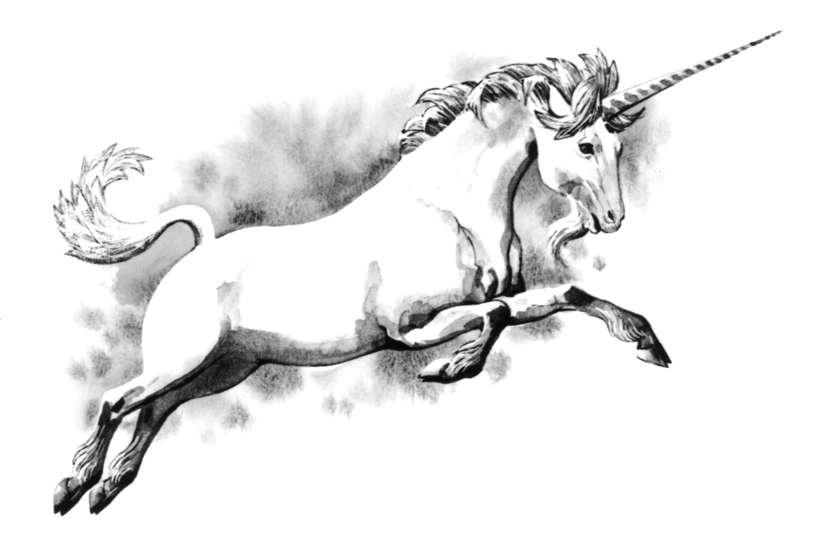
Binary Bastards

